Slide 1
Digital Signal Processing
- Summary Note of Lecture 1
Index
Lecture 1. Basic Signals Introduction /
Lecture 2.
24.02.10

Slide 2
Lecture 1. Introduction to DSP

Slide 3
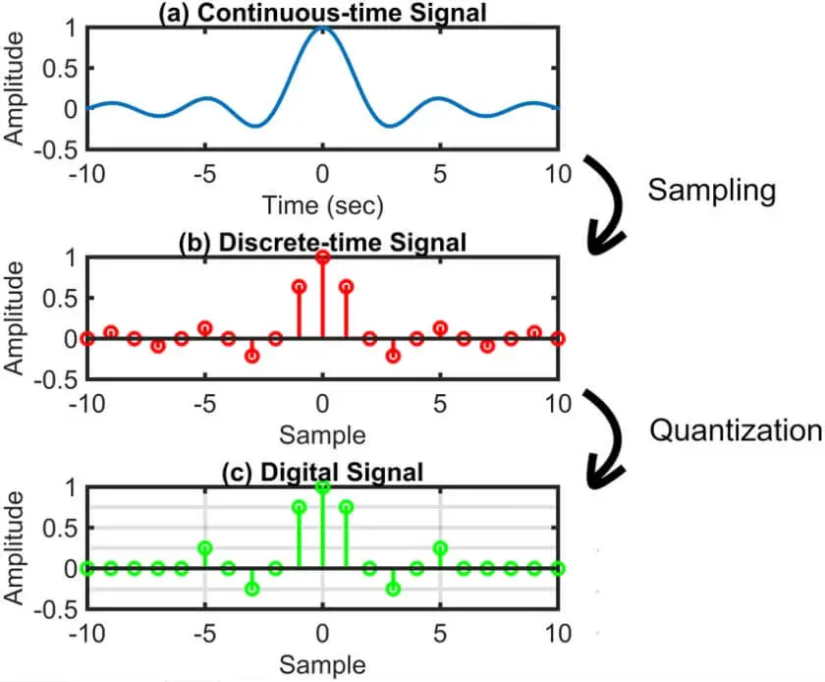
Signal
1. Continuous-time signal (Analog signal)
2. Discrete-time signal (Continuous-value)
3. Digital signal (Discrete-time & Discrete-value)
Independent
var
dependent
var
Continuous
Discrete
Continuous
Continuous-time
signal
Discrete-time
signal
Discrete
X
Digital signal
Digital Signal Processing – Lecture 1

Slide 4
Lecture 2.
Definition & Classification of signal

Slide 5
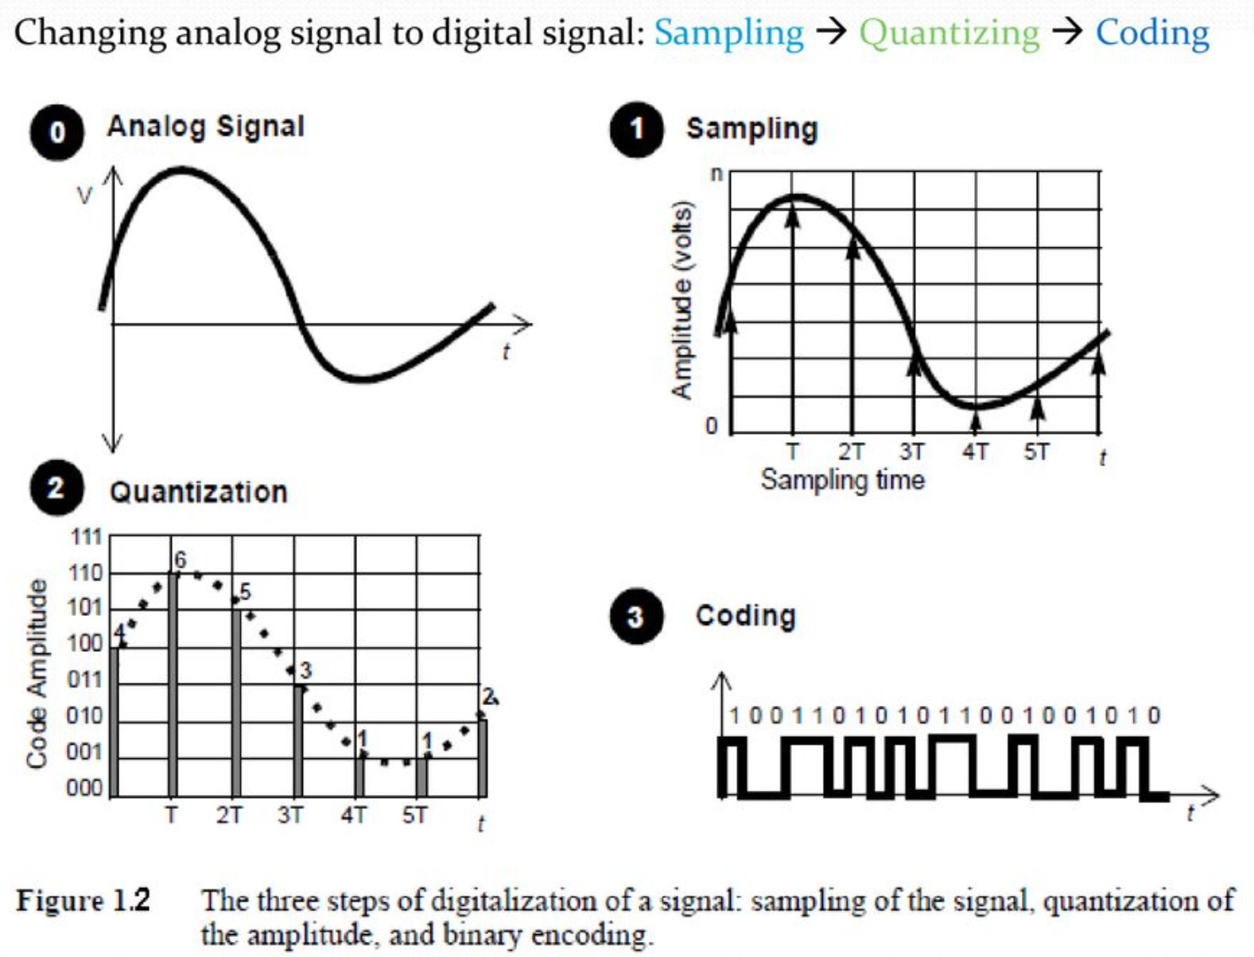
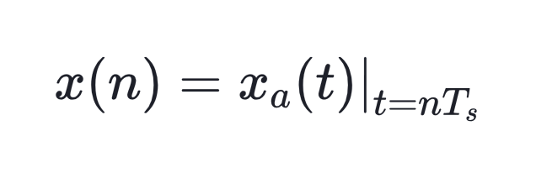
Analog to Digital conversion
일반적으로 Analog 신호를 Digital 신호로 변환해서 신호처리 하는 것이 효율적이므로, A/D Conversion을 수행한다.
Steps for A/D Conversion
① Sampling
Analog signal → Discrete-time signal
② Quantization
Discrete-time signal → Digital signal
(CPU는 Finite # of bit를 가지므로 Quantization은 불가피하다.
③ Encoding
Digital Signal Processing – Lecture 2

Slide 6
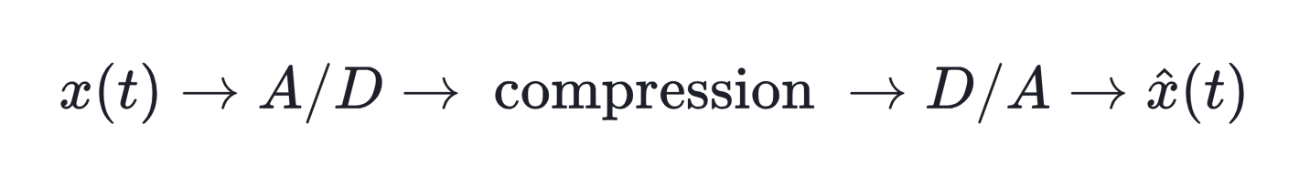
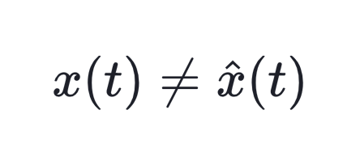
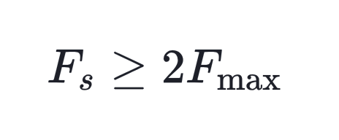
Analog to Digital conversion
Analog 신호를 A/D conversion 하는 과정에서 원래 신호의 정보 손실이 발생한다.
① Sampling 과정
# Sampling theorem
The analog signal can be exactly reconstructed from its discrete-time version, only if the sampling rate F_{s} is greater than or equal to twice of the maximum frequency content of the analog signal.
Sampling theorem을 만족하면, Sampling 과정에서 정보의 손실이 발생하지 않고
원래 신호를 완벽하게 복원할 수 있다.
Digital Signal Processing – Lecture 2

Slide 7
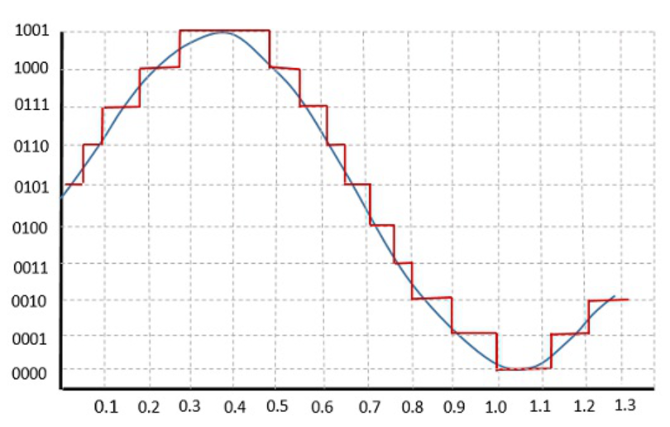
Analog to Digital conversion
② Quantization 과정
Quantization Error는 무한히 많은 bit를 사용하지 않는 이상, 제거할 수 없다.
단, bit 수를 증가시킴으로써, Quantization Error를 최소화할 수 있다.
Digital Signal Processing – Lecture 2

Slide 8
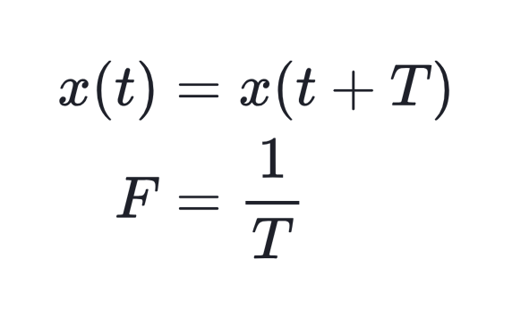
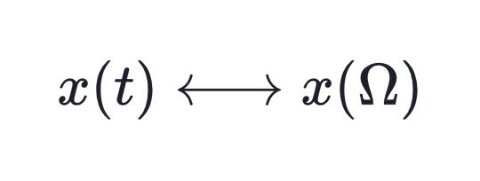
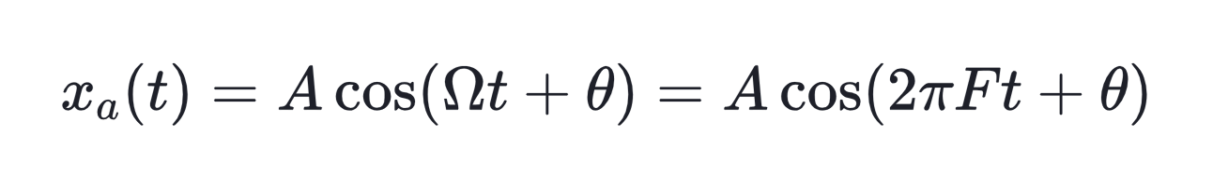
Frequency
① Narrow-band meaning
② Wide-band meaning
Fourier 표현식에 따른, 시간 변수 t의 또 다른 표현식
Digital Signal Processing – Lecture 2

Slide 9
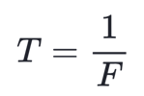
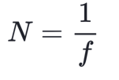
Sinusoidal signal
① Continuous-time signal
(Frequency)
② Discrete-time signal
(Frequency)
Digital Signal Processing – Lecture 2

Slide 10
Sinusoidal signal
① Continuous-time signal
ㆍ
ㆍ
(Frequency)
② Discrete-time signal
ㆍ
ㆍ
(Frequency)
Digital Signal Processing – Lecture 2

Slide 11
Sinusoidal signal
① Continuous-time signal
ㆍ
ㆍ
(Frequency)
② Discrete-time signal
ㆍ
ㆍ
(Frequency)
Digital Signal Processing – Lecture 2

Slide 12
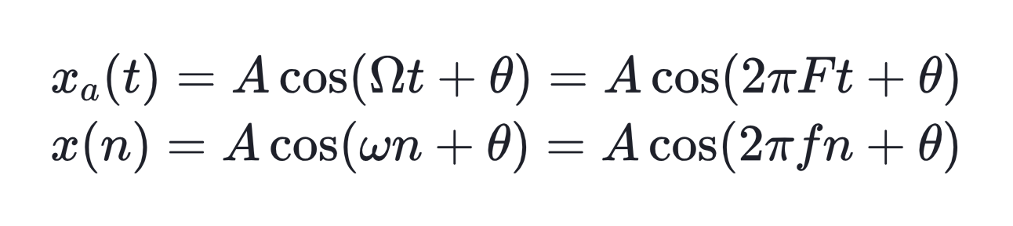
·
(Frequency)

